Slide 1

Narasarao peta engineering college
Youtube TrendingVideoMetadata Analysis Using Machine Learning
Under the estimated guidance of
M.Venkata Rao
Batch No: CB-7
Team members:
T.Gopi(19471A05I8)
G.Karthik(19471A05E6)

Slide 2
CONTENT
Abstract
Literature Survey
Proposed methods/system
Methodologies/design
Requirement Specification
References
outputs
Conclusion

Slide 3
ABSTRACT
Data Analysis and Mining are becoming indispensable part of every major organization to find recent trends and statistics and formulate business strategies, planning and marketing. However, most of the Data generated is generally in Huge Size and comes in unstructured format
Big Data cannot be analyzed by traditional database systems and processes. To resolve this issue, many new tools that implement Parallel Processing are being deployed in these organizations.
Data Analysis and Visualization was done using Anaconda jupyter Notebook. Analysis of structured data has seen tremendous success in the past. However, analysis of large scale unstructured data in the form of video format remains a challenging area. YouTube, a Google company, has over a billion users and generates billions of views. Since YouTube data is getting created in a very huge amount and with an equally great speed, there is a huge demand.

Slide 4
LITERATURE SURVEY
A literature survey on YouTube trending video metadata analysis using the machine learning reveals that previous studies have focused on different aspects of YouTube's platform and content. Researchers have used machine learning algorithms to analyze YouTube videos and predict their popularity, engagement, and sentiment analysis.
There are many existing systems for analysing YouTube video meta data .Some of the populare ones are:
1.Google Trends – a free tool that provides insights into search trends and popularity of keywords related to YouTube videos.
2.VidIQ - a paid tool that provides analytics and optimization tools for YouTube videos to help creators increase their views and subscribers.
3.TubeBuddy - a paid tool that offers similar features to VidIQ.

Slide 5
Proposed methods/system
Building a tool that uses machine learning algorithms to predict the success of YouTube videos based on their metadata.
Overall, proposed system should aim to help YouTube creators optimize their videos for success and increase their views and subscribers.
At the same time show the meta data of top trending videos

Slide 6
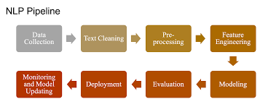
Methodologies /design

Slide 7
II. DATA SET DESCRIPTION
In this project we taken the dataset from Kaggle. Some of the columns are vedio_id ,trending date ,tumbnail ,likes Etc..,by using these different columns we can say or we can analyze the trending vedio.
III. DATA PREPROCESSING
Data preprocessing is a process in which raw data is transformed into an understandable and convenient format. In this paper data preprocessing is useful in resolving issues such as null values, categorical values like Students Data, are converted into numerical values, inconsistencies in data are removed. Unnecessary attributes for analysis in the dataset are removed.

Slide 8
IV. DATA VISUALIZATION
Data Visualization is the visual representation of data in the form of figures, graphs, charts. It is used to analyze massive amounts of data to understand the trends and patterns from data. Visual representation of Students marks and their percentages in the form of Bar Graphs,and Charts.
V. MODEL BUILDING
Predictive model is generated with the given set of instances.70% of the data set is considered for training the model and 30% of the dataset taken as testing data. Youtube trending vedio anlysis is fixed astarget variable.Model is built using various regression algorithms.

Slide 9
VI. RESULTS AND DISCUSSION
The Results presented in the paper clearly show that Random Forest Regression has the best performance in terms of Regression Score. Also it has very low absolute error, Mean Squared Error, And High Accuracy compared to other models.
VIII. FUTURE SCOPE
In this paper,model is built using machine learning to predict Youtube trending vedio anlysis. Here feature extraction of independent variables is done manually. Handcrafted feature engineering is replaced by automatic feature extraction using Machine learning. Also deep learning model handles exponentially growing dataset.

Slide 10
REQUIREMENTS OF THE PROJECT
Software Requirements :
Browser : Any Latest browser like Chrome
Operating System : Windows 10
Language :Python
Platform : Anakond jupitor note book
Hardware Requirements :
Processor : Intel(R) Core™2 i5-5500U CPU @
2.50GHZ
RAM : 8GB(gigabyte)
SystemType : 64-bit operating system , x64-
based processor

Slide 11
Links:
BASE PAPER:
https://www.researchgate.net/publication/342150876_Youtube_Trending_Video_Meta data_Analysis_Using_Machine_Learning
DATA SET:
https://www.kaggle.com/datasets/rsrishav/youtube-trending-video-dataset

Slide 12
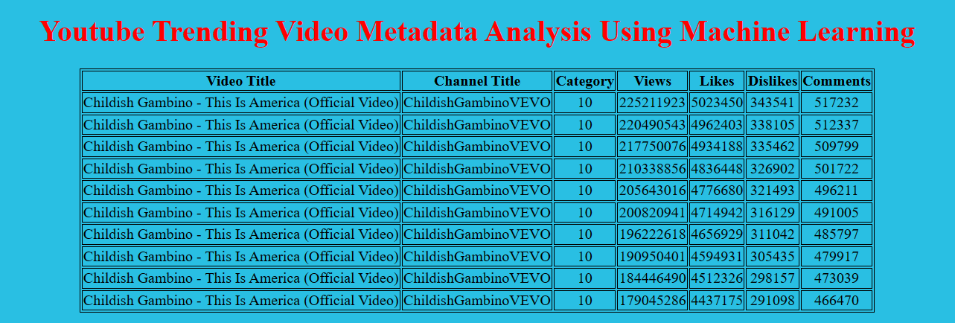
Outputs:
out put 1

Slide 13
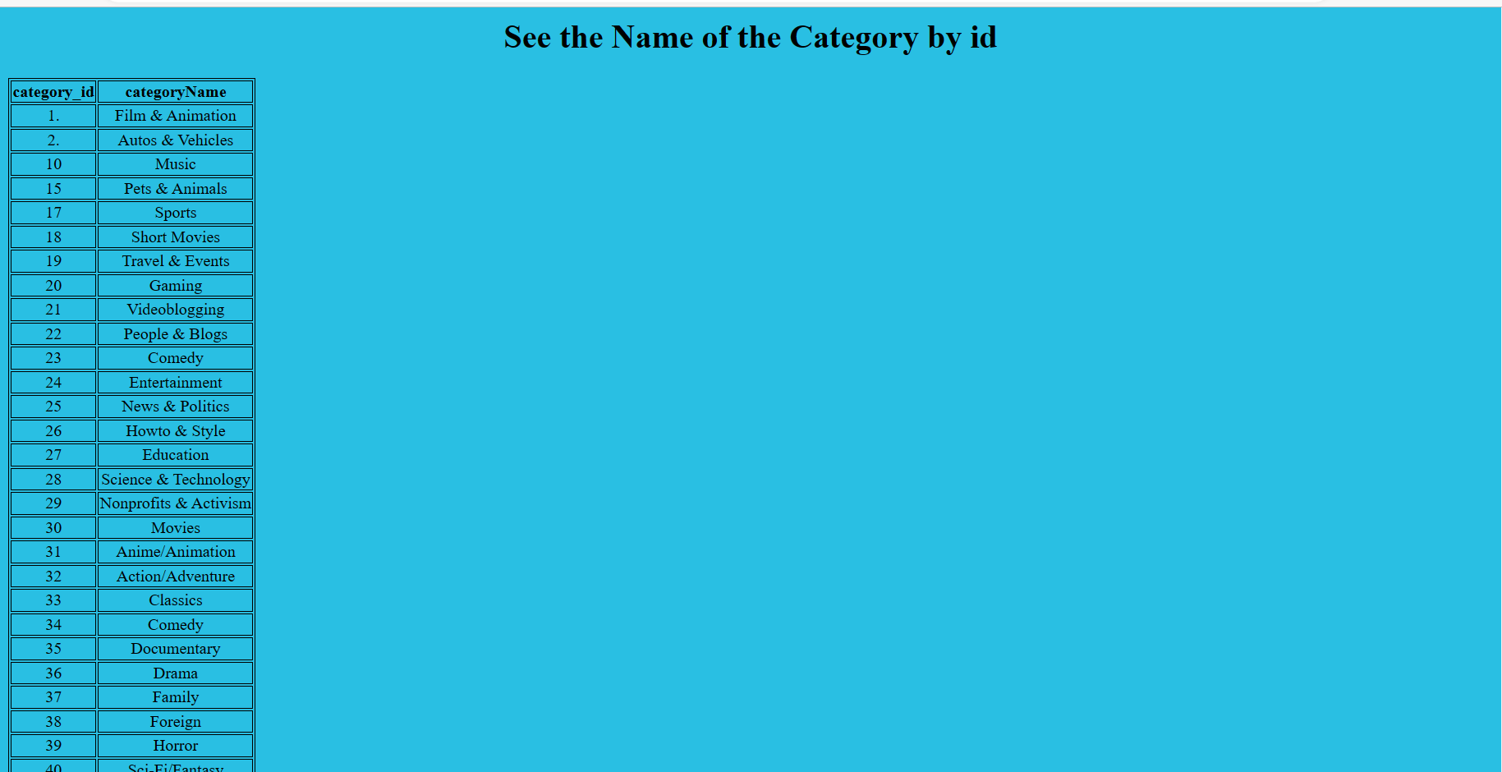
Out put 2

Slide 14
Conclusion:
The use of machine learning techniques in analysing large datasets of metadata has shown to be a valuable tool in understanding the factors that contribute to video trendiness on YouTube.
The study's findings revealed that specific factors, including the video's category, the title, the description, the view count, the comment count, likes, dislikes, had a notable influence on a video's Virality on YouTube.
Moreover, machine learning models such as the Linear Regression, Random Forest Regressor, and Decision Tree Regressor were instrumental in identifying and predicting the relationships between these factors and the popularity of trending videos were trained on the dataset, to achieving high accuracy scores.
The Linear Regression model score and R-squared score both achieved a score of 100%, while the Random Forest Regressor score achieved 99.98%. Based on these results, creators and marketers can optimize their content for YouTube's Trending section by paying close attention to these factors.
The findings of this study provide insights into the audience and content trends on YouTube and demonstrate the effectiveness of machine learning techniques in analysing large datasets of metadata

Slide 15
THANK YOU

